Slide 1
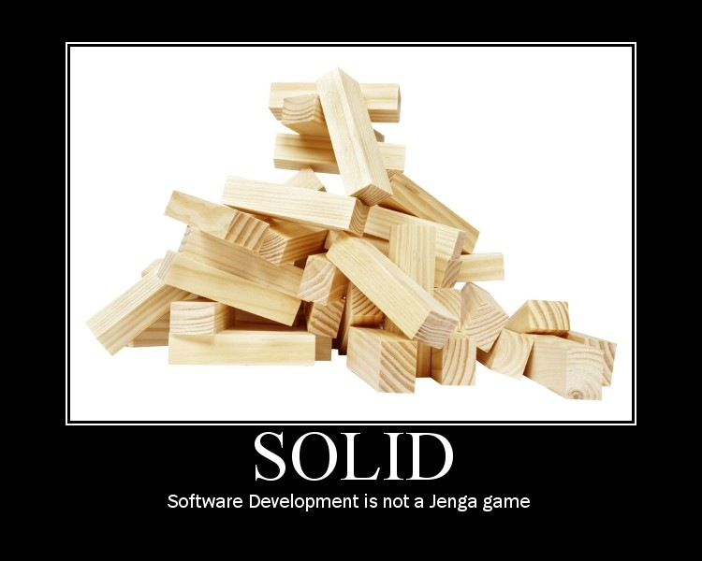
Notes:
Try to change one little thing and it all comes crashing down
Should not be this way
Many causes – most of which, in OO systems, boil to down to coupling
What is coupling?

Slide 2
Object Oriented Principles
They’re Not Just For Academics And Ivory Tower Architects
Notes:
OO is not about objects, directly. It’s about solving problems through models
OO is about the primary use of code / logic, first. Code re-use is low on the totem pole.
If you can’t correctly use your objects in the app they were built for, for the initial reason they were built, you have zero chance of ever re-using them successfully

Slide 3
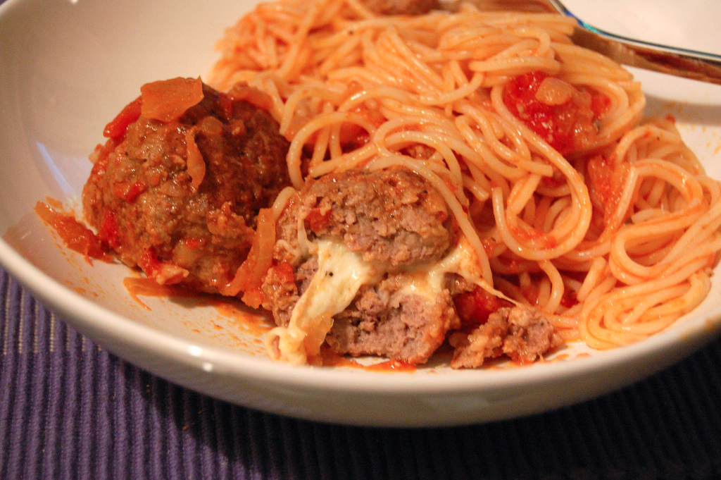
Coupling
Coupling:
“The degree to which each program module relies on each one of the other modules” – Wikipedia
Photo Source: http://www.flickr.com/photos/su-lin/2268003292/sizes/l/in/photostream/
Notes:
The spaghetti mess… if I just want the gooey goodness of the meatball, do I have to bring along the noodles that are attached to other meatballs?

Slide 4
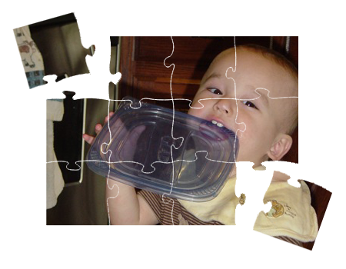
Cohesion
Cohesion:
“A measure of how strongly-related and focused the various responsibilities of a software module are” - Wikipedia
Notes:
the whole is greater than the sum of the parts.
A 10,000 line “god” class (all powerful, all knowing) cannot be cohesive, by definition

Slide 5

encapsulation
Encapsulation:
“The hiding of design decisions in a computer program that are most likely to change” - Wikipedia
Photo Source: http://www.flickr.com/photos/adamcrowe/4299996507/sizes/o/in/photostream/
Notes:
Information hiding, not just data hiding.
Properties are not encapsulation
Design decisions, logic, and behavior, which may be mixed with data / properties
A black box… but with an API to get something in and out.

Slide 6

But… How?
Photo Source: http://www.flickr.com/photos/hollysuewho/4943037329/sizes/l/in/photostream/

Slide 7
S.O.L.I.D. Software Development
Achieving Object Oriented Principles, One Step At A Time
Notes:
SOLID helps us get to the lofty goals of the OO principles
They give us a way to manage the dependencies in our app, which helps us create good OO software
But these are just principles, not laws. They have a context in which they apply, and there are times when they are not needed or they are applied differently

Slide 8
SOLID Principles
SRP: Single Responsibility Principle
OCP: Open Closed Principle
LSP: Liskov Substitution Principle
ISP: Interface Segregation Principle
DIP: Dependency Inversion Principle

Slide 9
Starting Simple
Example App: Read A Flat File And Send An Email
Email Sending App
File
Notes:
Basic requirements of the app: read a file, send an email.
Show the super simple demo app code

Slide 10
SRP: Single Responsibility Principle
“If a class has more then one responsibility, then the responsibilities become coupled. Changes to one responsibility may impair or inhibit the class’ ability to meet the others. This kind of coupling leads to fragile designs that break in unexpected ways when changed.”
- Robert C. Martin
Notes:
There can be only one
Its one reason to _change_ not one reason to exist.
What does that mean? Why is that perspective important?
The context of change, not the most finite technical slicing

Slide 11
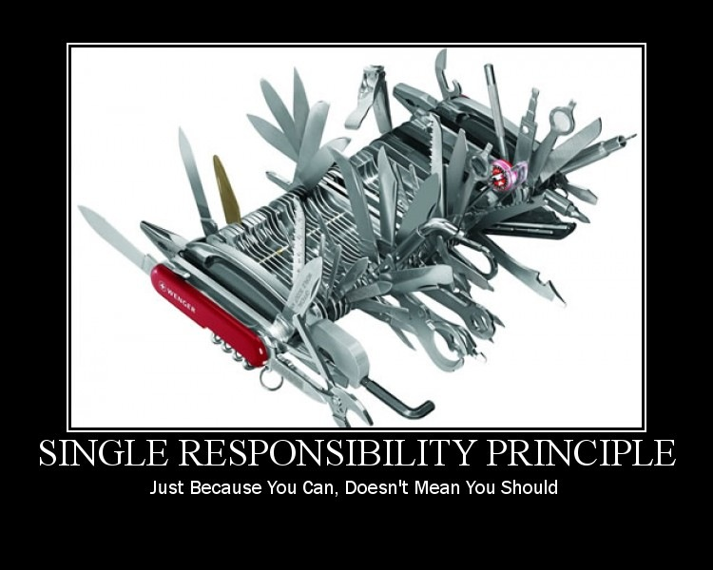
Notes:
Just because you can…
Got classes and cohesion
John tegue’s christmas-tree class. You just keep hanging things off of it
No more “utility” or “helper” or “manager” classes

Slide 12
Single Responsibility
Email Sending App
Email Sender
Flat File
XML File
Notes:
How many responsibilities in the original app design?
New requirement: flat file or xml file
Factor email sender out, to introduce single responsibility
Show code

Slide 13
Single Responsibility
Email Sender
Format Reader
Flat File
XML File
Notes:
Factor format reader out to introduce SRP, because multiple formats are needed.
Show code

Slide 14
OCP: Open Closed Principle
Modules that conform to open-closed have two primary attributes:
They are “Open For Extension”
They are “Closed for Modification”
- Robert C. Martin
Notes:
There is no spoon
Don’t “bend the spoon” (change our code), but bend ourselves…
change the behavior of the code without changing the code

Slide 15
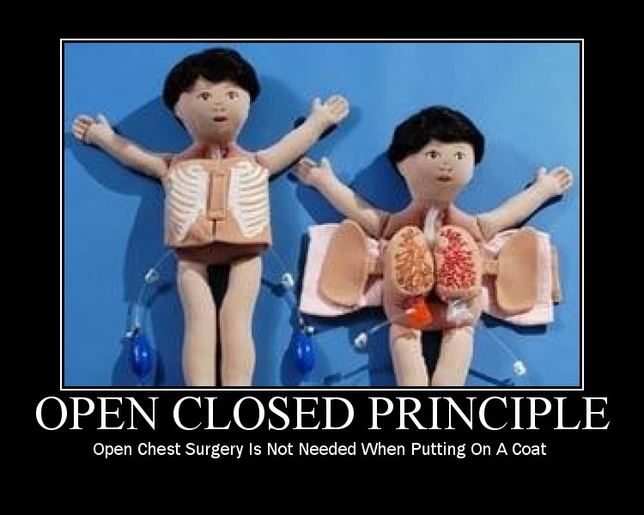

Slide 16
Open-Closed
File Reader
Service
Email Sender
IFile Format Reader
Flat File
XML File
Notes:
Introducing an interface: a generalized role
Implementing the interface for each file type reader.
Allows new file types to be added without changing the format reader service
Show the code

Slide 17
LSP: Liskov Substitution Principle
“If for each object o1 of type S there is an object o2 of type T such that for all programs P defined in terms of T, the behavior of P is unchanged when o1 is substituted for o2 then S is a subtype of T.”
- Barbara Liskov
Notes:
It’s about not violating the semantics of the API you are replacing
Sometimes semantic arguments are worthwhile

Slide 18
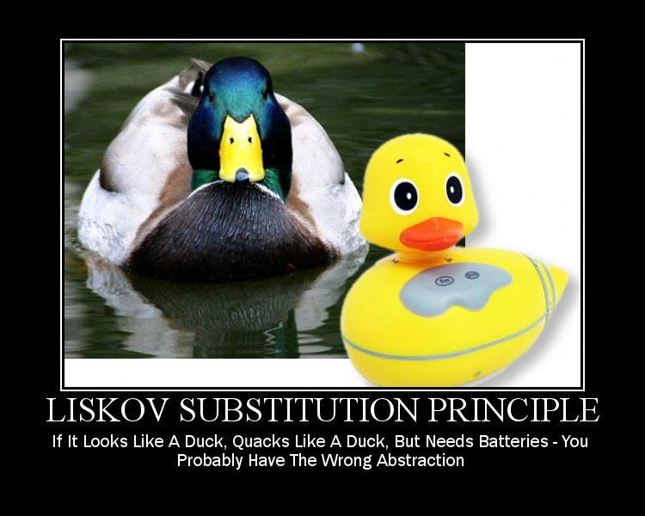
Notes:
Sometimes an abstraction looks good on the surface, but fails in the implementation

Slide 19
Liskov Substitution
Square
Rectangle
!=
Notes:
Show the code

Slide 20
Liskov Substitution
Database
FileReader
Service
Email Sender
IFileFormat Reader
Flat File
XML File
Database Connection File
Notes:
A database reader vs a file reader, and using a switch on the type to call or not call specific things

Slide 21
Liskov Substitution
Database
Database
Reader
Service
Flat File
Email Sender
IFileFormat Reader
FileReader
Service
XML File
Notes:
Correction the violation by not sharing an abstraction. Keep the database and file readers separate for now
Show the code
(note: Purposely not introducing a shared abstraction between them at this point. That comes later.)

Slide 22
ISP: Interface Segregation Principle
“Classes that have ‘fat’ interfaces are classes whose interfaces are not cohesive. In other words, the interfaces of the class can be broken up into groups of member functions. Each group serves a different set of clients.”
- Robert Martin
Notes:
Protocols and role specific interfaces
Limiting the API that a client must see or know about

Slide 23
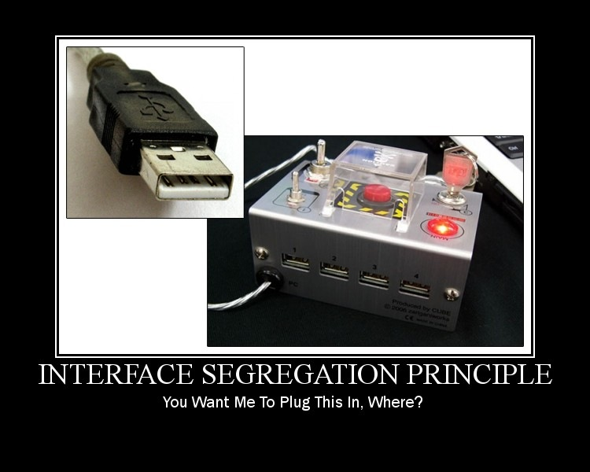

Slide 24
Interface Segregation
EmailSender
EmailSender
Database Reader
Service
SendEmail
ReadFile
ReadFromDb
SendEmail
GetMessageBody
FileReader
Service
GetMessageBody
Notes:
The email sender has too many responsibilities and it has an API that’s too fat
Split it up
Show the code

Slide 25
DIP: Dependency Inversion Principle
“A design is rigid if it cannot be easily changed. Such rigidity is due to the fact that a single change to heavily interdependent software begins a cascade of changes in dependent modules.”
- Robert Martin
Notes:
Ownership: posession is 90% of the law

Slide 26
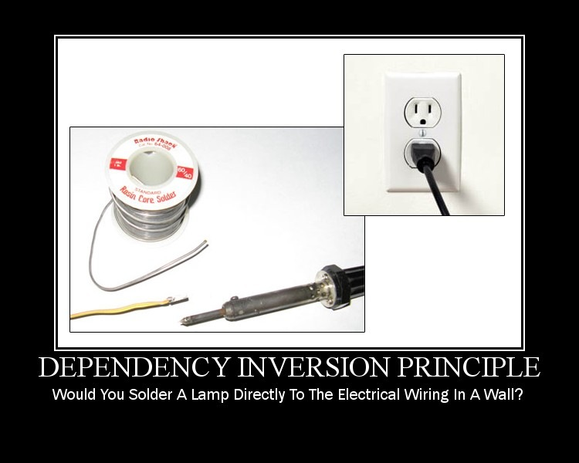

Slide 27
Dependency Inversion
Foo
Bar
Notes:
You can’t write a system without dependencies

Slide 28
Dependency Inversion
Foo
IBar
Bar
Notes:
A header interface is not inversion, it’s only abstraction

Slide 29
Dependency Inversion
Foo
IRoleName
Bar
Notes:
It’s about the owner of the interface, not just having an interface
Role specific interfaces provide what the client needs,

Slide 30
Dependency Inversion
Xml File Reader
Flat File Reader
IFileFormat Reader
Database Reader Service
File Reader Service
Email Sender
IMessageInfoRetriever
IEmailService
ProcessingService
Notes:
Introducing the imessageinforetriever as an abstraction between the different reader types
The interface is owned by the processing service
The implementations change to meet the needs of the processing service, not the other way around
Show the code

Slide 31
Summarizing Our S.O.L.I.D. Conversion
Compare And Contrast The Original Code To The New Code

Slide 32
What Did We DO?
IMessageInfo
Retriever
IEmailSender
Email Sending App
EmailProcessingService
Flat File
Database
Database
Reader
Service
IMessage
Info
Retriever
File
XML File
IFileFormat Reader
FileReader
Service
EmailService
IEmail
Service
Before
After
Notes:
As we added functionality, we introduced principles and patterns that make it easier to continue adding functionality later
We blew up the object graph from 2 things that did everything to 12 things
But why?

Slide 33
Why? … Coupling
IMessageInfo
Retriever
IEmailSender
EmailProcessingService
Flat File
Database
Database
Reader
Service
IMessage
Info
Retriever
XML File
IFileFormat Reader
FileReader
Service
EmailService
IEmail
Service
Notes:
SRP, OCP, ISP, LSP
Our system is decoupled.
Can pull pieces out and replace them
Each piece can change easily
Add new functionality easily

Slide 34
Why? … Cohesion
IMessageInfo
Retriever
IEmailSender
EmailProcessingService
Flat File
Database
Database
Reader
Service
IMessage
Info
Retriever
XML File
IFileFormat Reader
FileReader
Service
EmailService
IEmail
Service
Notes:
DIP, SRP, LSP
The app as a whole does more than the individual parts
All the parts work well by themselves, but they work better when coordinated together
code re-use is low on the totem pole? good OO architecture and high cohesion means we are more likely to be able to re-use, without making re-use a goal

Slide 35
Why? … Encapsulation
IMessageInfo
Retriever
IEmailSender
EmailProcessingService
Flat File
Database
Database
Reader
Service
IMessage
Info
Retriever
XML File
IFileFormat Reader
FileReader
Service
EmailService
IEmail
Service
Notes:
SRP, ISP, OCP
With each part of the app well encapsulated, we have no duplication
We can segment the parts of the app for a number of reasons: testing, giving responsibility to certain developers, etc
We can change parts of the app and it’s behavior without touching the rest of the app

Slide 36
Additional Resources
Uncle Bob’s Principle Of Object Oriented Development:
http://butunclebob.com/ArticleS.UncleBob.PrinciplesOfOod
Pablo’s Topic Of The Month on SOLID, SOLID E-Book, and more
http://lostechies.com
SOLID Software Development in CODE Magazine
http://www.code-magazine.com/article.aspx?quickid=1001061
Agile Principles, Patterns, And Practices In C#
by Robert and Micah Martin, published by Prentice Hall
Derick Bailey - Independent Consultant
Muted Solutions, LLC
WWW:
mutedsolutions.com
derickbailey.lostechies.com
Email:
derick@mutedsolutions.com
derick@derickbailey.com
Twitter:
@derickbailey
Copyright ©2011 Muted Solutions, LLC

